Slide 1
Undulator 1 Pulsed-wire alignment

Slide 2
Initial Wire Position
x1,y1 denote positions of post on entrance side. X2,y2 denote positions of post on exit side.
X1,y1 = (12, 18)
X2, y2 = (11, 12)
We will use “xtraj vs yoffset” and “ytraj vs xoffset” scans to measure magnetic axis along the undulator.
Because the linear region of the laser/photodiode pair can be small, we take measurements of the velocity (guaranteed flat signal) to calibrate mean signal (mV) vs Amplitude. This makes the ideal operating mV scope reading clear.

Slide 3
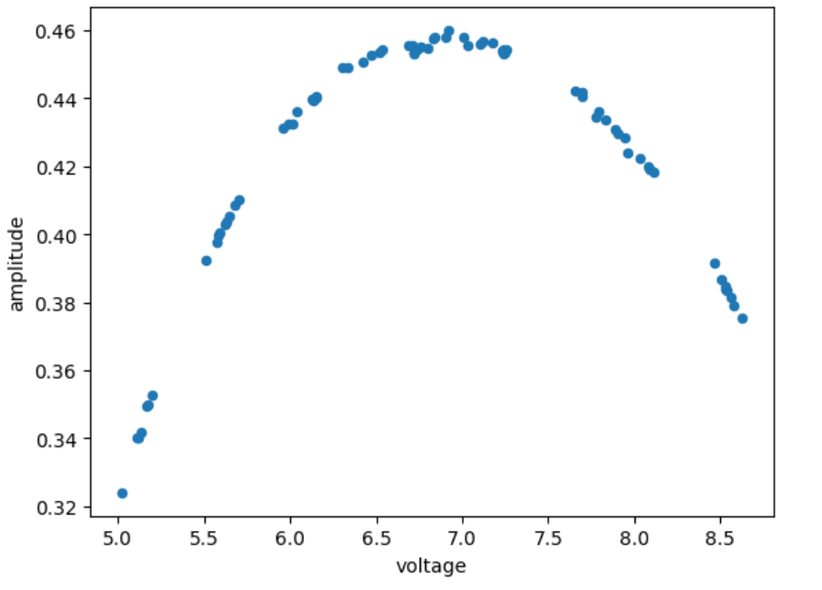
Xtraj vs Yoffset
Create_laser_calibration_curve computes the aggregate voltage and amplitude for a given number of trajectory (flat) signals.
It is clear to see the nonlinearity of the “linear” region due to diffraction.
A polynomial fit can be used as a correction for trajectory measurements.

